Slide 1



Group Members
Allamprabhu Hiremath
Pallavi Zadokar
Sayali Joshi

Slide 2


▶ X Education sells online courses to industry professionals.
▶ X Education gets a lot of leads, its lead conversion rate is very poor. For example, if, say, they acquire 100 leads in a day, only about 30 of them are converted.
▶ To make this process more efficient, the company wishes to identify the most potential leads, also known as ‘Hot Leads’.
▶ If they successfully identify this set of leads, the lead conversion rate should go up as the sales team will now be focusing more on communicating with the potential leads rather than making calls to everyone.
Business Objective:
▶ X education wants to know most promising leads.
▶ For that they want to build a Model which identifies the hot leads.
▶ Deployment of the model for the future use.

Slide 3
Solution Methodology
Data cleaning and data manipulation.
Finding duplicate data.
Find and drop null values.
Replace null values.
Manage outliers.
EDA
Univariate data analysis: Variables counts
Bivariate data analysis: Identifying patterns and correlation coefficients.
Feature Scaling & Dummy Variables and encoding of the data.
Classification : Logistic Regression used for the model making and prediction analysis.
Model Validation and Presentation.
Conclusions and Suggestions.

Slide 4
Data Manipulation
▶ Total Number of Rows =37, Total Number of Columns =9240.
▶ Single value features like “Magazine”, “Receive More Updates About Our Courses”, “Update me on Supply”
▶ Removing the “Prospect ID” and “Lead Number” which is not necessary for the analysis.
▶ After checking for the value counts for some of the object type variables, we find some of the features which has no enough variance, which we have dropped, the features are: “Do Not Call”, “What matters most to you in choosing course”, “Search”, “Newspaper
Article”, “X Education Forums”, “Newspaper”, “Digital Advertisement” etc.
▶ Dropping the columns having more than 35% as missing value such as ‘How did you hear about X Education’ and ‘Lead Profile’.

Slide 5
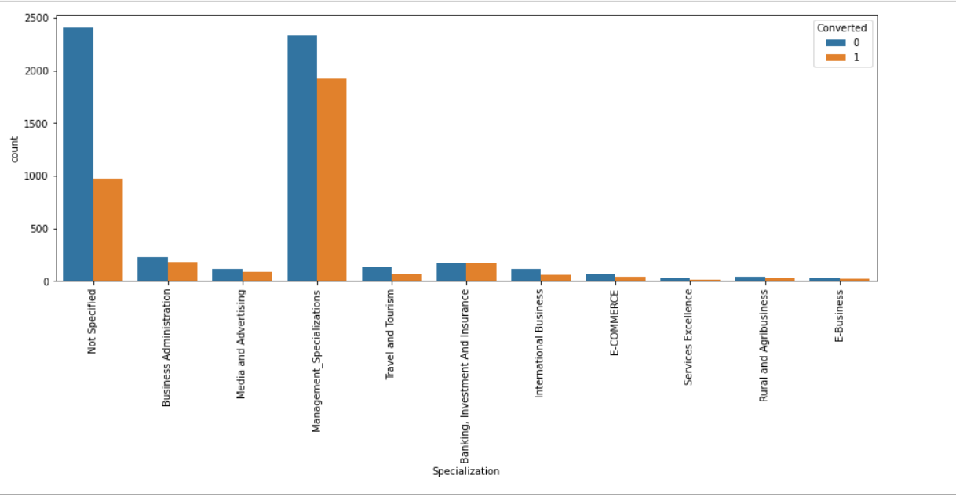
EDA

Slide 6
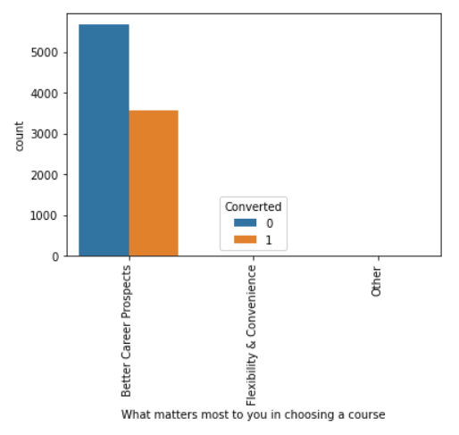
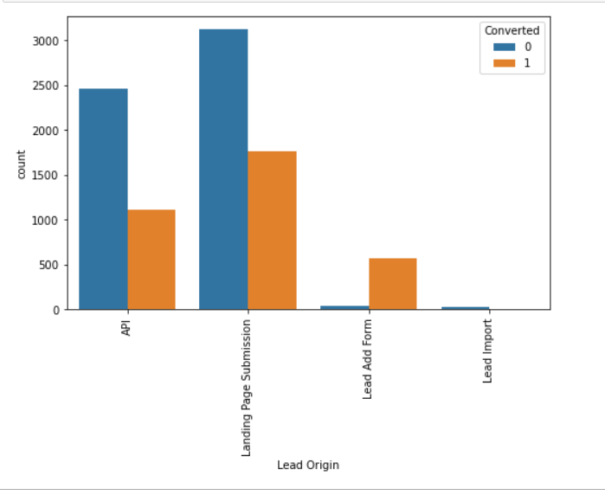
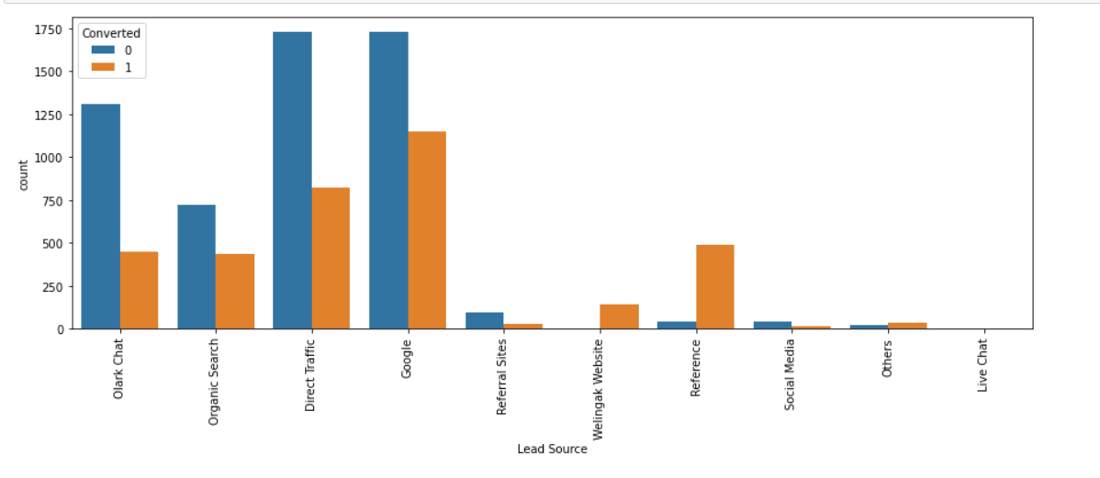

Slide 7
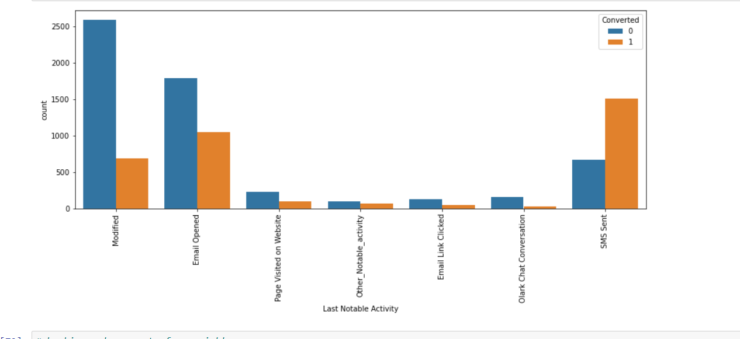

Slide 8
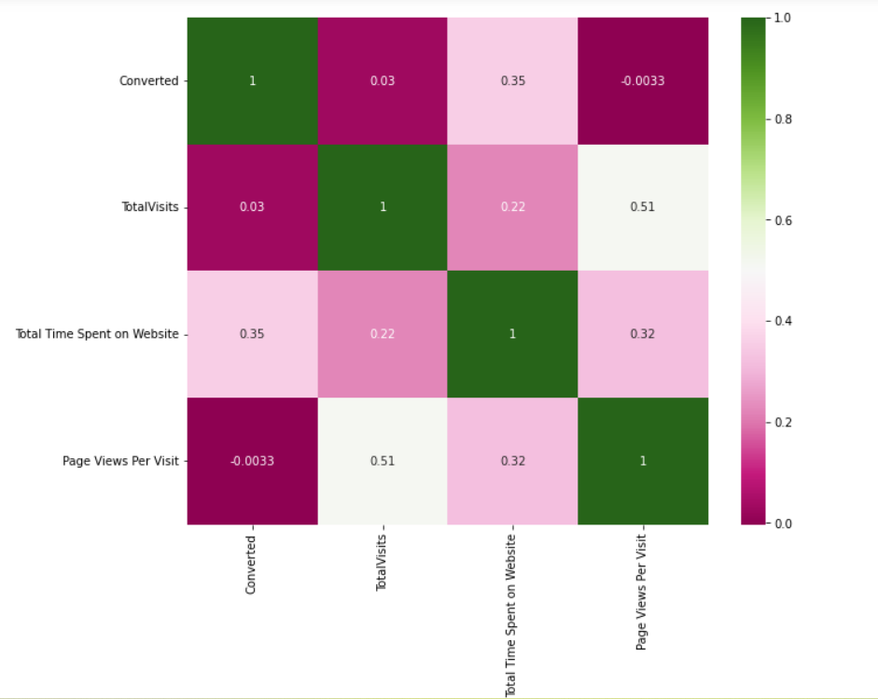
Correlation

Slide 9
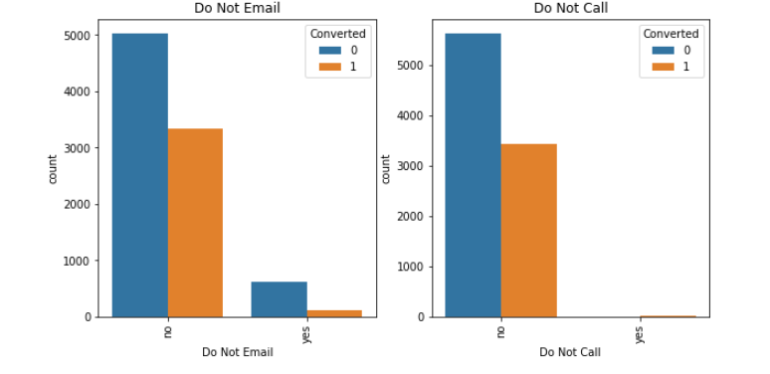

Slide 10
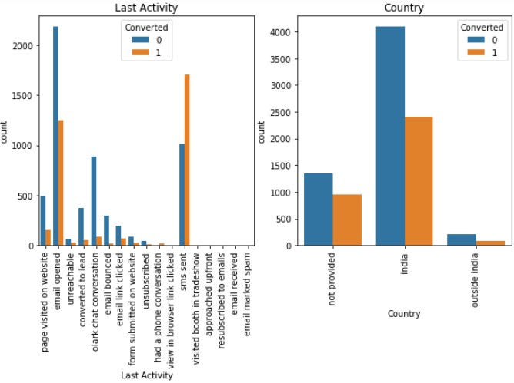

Slide 11
Data Conversion
▶ Numerical Variables are Normalised
▶ Dummy Variables are created for object type variables
▶ Total Rows for Analysis: 8792
▶ Total Columns for Analysis: 43

Slide 12
Model Building
▶ Splitting the Data into Training and Testing Sets
▶ The first basic step for regression is performing a train-test split, we have chosen 70:30 ratio.
▶ Use RFE for Feature Selection
▶ Running RFE with 15 variables as output
▶ Building Model by removing the variable whose p- value is greater than 0.05 and vif
value is greater than 5
▶ Predictions on test data set
▶ Overall accuracy 81%

Slide 13
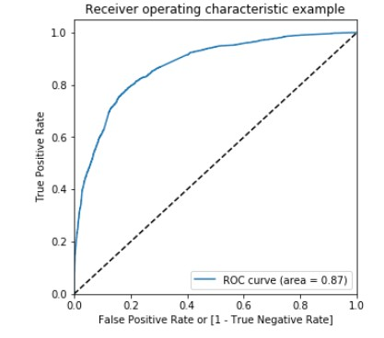
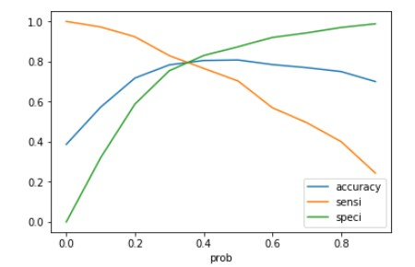
ROC Curve
▶ Finding Optimal Cut off Point
▶ Optimal cut off probability is that
▶ probability where we get balanced sensitivity and specificity.
▶ From the second graph it is visible that the optimal cut off is at 0.35.

Slide 14
Conclusion
It was found that the variables that mattered the most in the potential buyers are (In descending order
The total time spend on the Website.
Total number of visits.
When the lead source was:
Google
Direct traffic
When the last activity was:
SMS
Olark chat conversation
When their current occupation is as a working professional, keeping these in mind the X Education can flourish as they have a very high chance to get almost all the potential buyers to change their mind and buy their courses.

